Slide 1

“ToDo-list”
Task - 5

Slide 2

YourꢀProjectꢀName
▪ YourꢀProjectꢀIntroduction
LMS Username
Name
Batch
A8_11
2115a812
S.KABIL

Slide 3

Taskꢀ5ꢀ::ꢀHostingꢀ(Moduleꢀ5)
Hostingꢀtheꢀwebsiteꢀsoꢀthatꢀitꢀcanꢀbeꢀaccessedꢀfromꢀanywhere
▪ Hostꢀbackendꢀonꢀawsꢀwithꢀallꢀenvironmentꢀsetup
▪ Makeꢀsureꢀtoꢀwhitelistꢀapiꢀportsꢀandꢀhostꢀwithꢀtheꢀdatabase
▪ Migrateꢀdatabaseꢀtoꢀmongodbꢀatlas
▪ Buildꢀreactꢀappꢀtoꢀbeꢀhostedꢀonꢀtheꢀserver
▪ Setꢀhostedꢀbackedꢀurlꢀtoꢀtheꢀfrontend
▪ Testꢀentireꢀfrontendꢀandꢀbackend
EvaluationꢀMetric:
100%ꢀCompletionꢀofꢀtheꢀaboveꢀtasks
Learningꢀoutcome
▪ Understandꢀhowꢀtoꢀhostꢀaꢀwebꢀapi
▪ Howꢀtoꢀdeployꢀproductionꢀreadyꢀreactꢀapplications
▪ Settingꢀupꢀenvironmentꢀforꢀproduction

Slide 4

Step-WiseꢀDescription
Ø Choose a hostng plateform to host the frontend and backend like AWS,render,netlify
etc.
Ø Setꢀupꢀaꢀserver:ꢀOnceꢀyou'veꢀchosenꢀaꢀhostingꢀplatform,ꢀyou'llꢀneedꢀtoꢀsetꢀupꢀaꢀserverꢀtoꢀhostꢀyourꢀ
todoꢀlistꢀapplication.ꢀ
Ø Installꢀaꢀdatabase:ꢀYourꢀtodoꢀlistꢀwillꢀneedꢀtoꢀstoreꢀdata,ꢀsoꢀyou'llꢀneedꢀtoꢀinstallꢀaꢀdatabaseꢀsuchꢀasꢀ
MySQLꢀorꢀmongodbꢀorꢀanythingꢀelse.
Ø Chooseꢀaꢀprogrammingꢀlanguageꢀandꢀframework:ꢀYou'llꢀneedꢀtoꢀchooseꢀaꢀprogrammingꢀlanguageꢀ
andꢀframeworkꢀtoꢀbuildꢀyourꢀtodoꢀlistꢀapplication.
Ø Developꢀandꢀdeployꢀyourꢀapplication:ꢀUsingꢀyourꢀchosenꢀprogrammingꢀ
languageꢀandꢀframework,ꢀdevelopꢀyourꢀtodoꢀlistꢀapplicationꢀandꢀdeployꢀitꢀtoꢀ
yourꢀserver.
Summaryꢀofꢀyourꢀtask
The todo application which is created using MERN was deployed in render
successfully.All the dependencies has been downloaded successfully which makes
the todolist more stable .The configuration was made so perfectly that it suites
various environment.

Slide 5
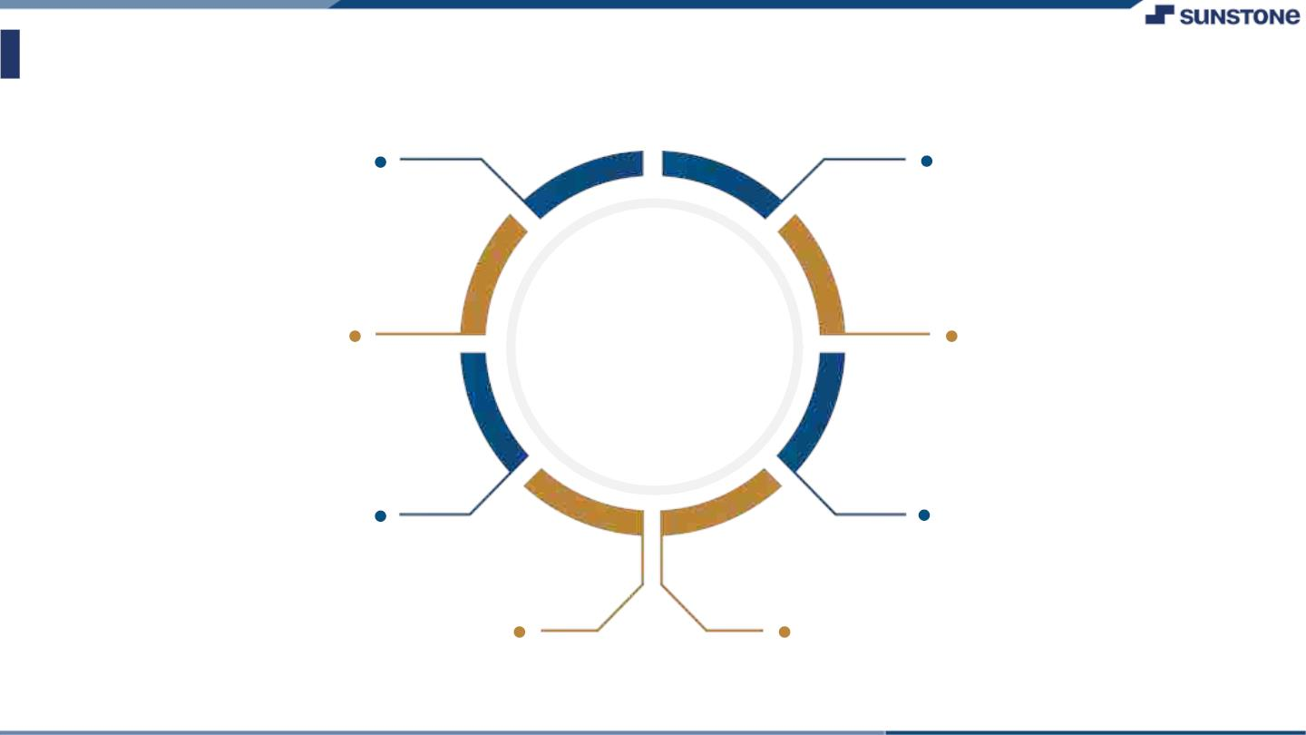
AssessmentꢀParameter
createꢀAWSꢀEC2ꢀinstance
buildꢀyourꢀreactꢀapplicationꢀforꢀproduction
addꢀallꢀdependenciesꢀrequiredꢀforꢀ
deployment
Check-List
forwaredꢀrequiredꢀportsꢀonꢀec2ꢀ
instance
Migrateꢀentireꢀdatabaseꢀtoꢀ
mongodbꢀatlas
setꢀallꢀenvironmentꢀvarialbleꢀ
withsꢀappropriateꢀvalues
runꢀnodeꢀserverꢀonꢀdevelopmentꢀusingꢀpm2ꢀ
serviceꢀmanager
Hostꢀyourꢀreactꢀapplicationꢀonꢀ
server

Slide 6

Submission Github
T

Slide 7


